Slide 1
BIO MEDICAL MRI IMAGES PATIENT REPORT GENERATION

Slide 2
MRI IMAGES REPORT GENERATION
PROBLEM STATEMENT:
The MRI images contain various information, from which a radiologist generates the diagnosis report for the patient. Medical imaging is widely used in clinical practice for diagnosis and treatment.
Writing a clinical report can be error-prone for inexperienced radiologists, and time consuming and tedious for experienced radiologists.
There are miniscule details in these images, which might not be captured by the human eye. Moreover, the clinical report might vary from one radiologist to another for the same set of MRI images of a patient.
To address these issues, we study the automatic generation of medical imaging reports. This task presents several challenges.
A complete report contains multiple heterogeneous forms of information, including findings and tags.
Abnormal regions in medical images are difficult to identify.
The reports are typically long, containing multiple sentences.
We have tried to create a solution for this problem by auto-generating these clinical diagnostic reports by applying the convolutional layers and sequence-to-sequence NLP modeling concepts. The model learns from the historical MRI images of the Lumbar Spine along with their corresponding clinical notes for 510 patients

Slide 3
DataSet
In order to train the model for the generation of clinical text report for the MRI images of a patient, we have taken the MRI images of 510 patients along with their clinical notes prepared by the radiologists.
We pass the MRI images of the new patient to the trained model for the generation of the clinical text report.
We have used the dataset available publicly, which consists of the Lumbar Spine MRI images of 510 patients having a total of 48,345 MRI slices. There are six different views of MRI images per patient.
Each patient has multiple MRI images and the radiologist report (clinical notes) associated with those images.
Image count for the patients ranges from 62 to 783. Total number of images for all the patients is 48,345. Average count of images per patient is roughly 94.
This dataset contains annotations by expert radiologists for the Lumbar Spine MRI Dataset. The notes contain information regarding the observed characteristics, condition of the lumbar spine, or presence of diseases, these include bone marrow disease, end plate degeneration, IVD bulges, Thecal Sac compression, central or foraminal stenosis, annular tears, scoliosis, endplate defects (Modic type), facet joint and Ligamentum Flavum hypertrophy, and spondylolisthesis
https://data.mendeley.com/datasets/k57fr854j2/2

Slide 4
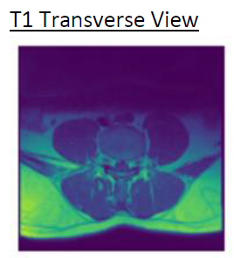
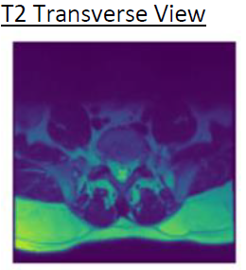
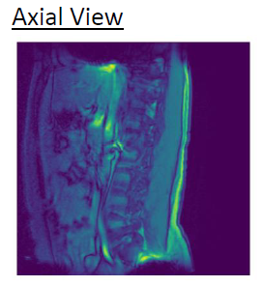
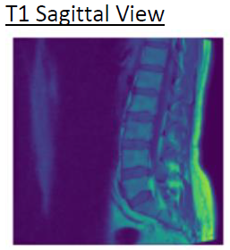
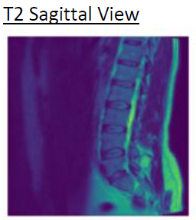
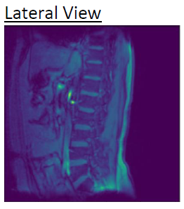
Patient MRI Images and Clinical Report
MRI Six Image views :
Report : LSS MRI :Feature of muscle spasm.Diffuse disc bulge noted at L4/L5 level ,mildly compressing the thecal sac and both exit nerve roots

Slide 5
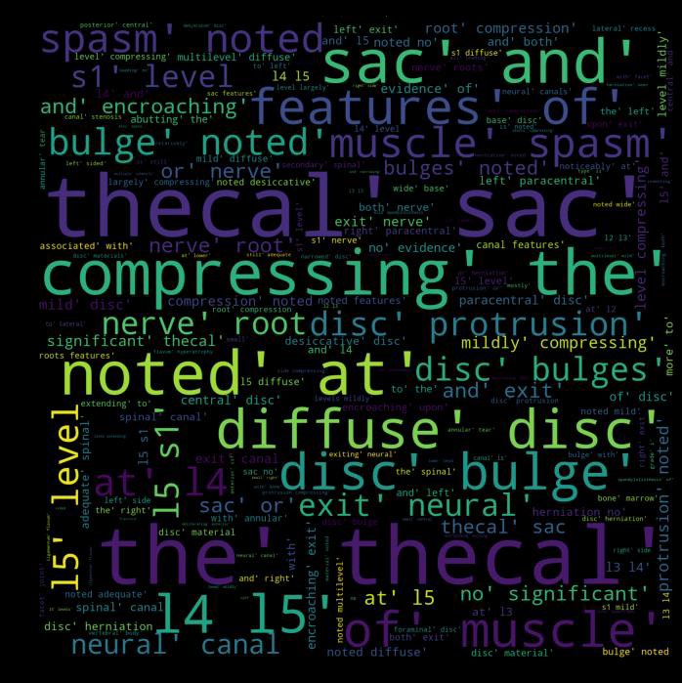
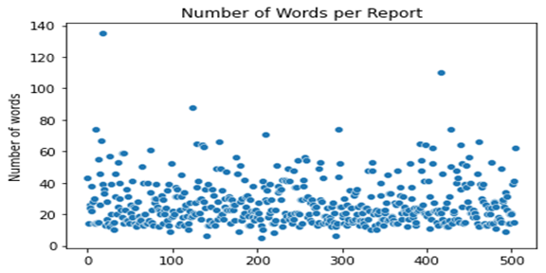
Patient Clinical Report EDA
Word Cloud
Fig.1
Fig.2
After cleaning and processing of the reports we have analyzed as per the Fig.1 number of words in report vary across the patients, so we have post padded the sequence with max length (135).
Plotted the word cloud Fig. 2, which gives in-depth visualization of the popular words based on frequency and relevance.

Slide 6
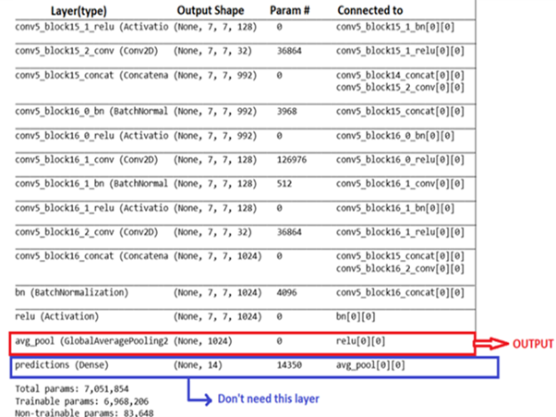
Algorithms and Solution
ChexNet Model:
ChexNet, is a 121-layer convolutional neural network trained on ChestX-ray14, currently the largest publicly available chest X-ray dataset, containing over 100,000 frontal-view X-ray images with 14 diseases.
However, our purpose here is not to classify the images but just to get the bottleneck features for each image. Therefore, we removed the last classification layer of this network.We have used pre-trained ChexNet Model weights for our Images

Slide 7
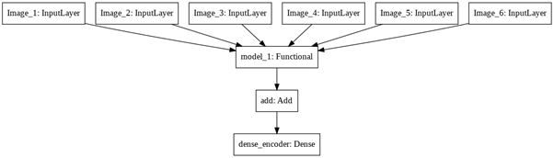
Algorithms and Solution
Encoder Model:
Six views of MRI image in numpy array format are passed to the ChexNet Model which consist of 426 layers of which 350 layers are made non-trainable and rest 76 layers as trainable.
Input of each ChexNet Model is (224, 224, 3) and output is (1024). For all the six ChexNet model output is added using Tensor flow Addition layer.
After the ChexNet Model, Dense layer is added to the model which generates an output of 256.

Slide 8
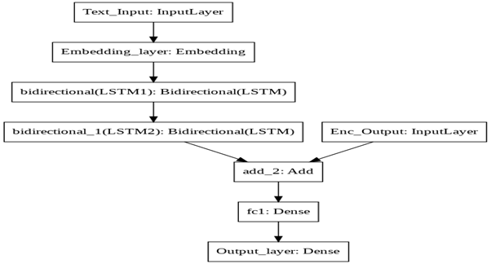
Algorithms and Solution
Decoder Model:
After cleaning and processing data for each patient, notes of every patient are post-padded with a maximum length of 135.
TensorFlow Embedding layer is added to the model whose input dimension is the vocabulary size (696), output dimension is 200 and input length of 135. Weights generated using the PubMed word embedding earlier are fed to the layer. Embedding layer is made non-trainable.
Two Bidirectional LSTM layers are added to the model so the model can learn reports from starting and end on both sides.

Slide 9
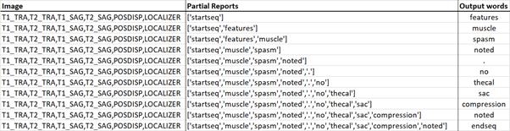
OUTPUT REPORT
Output report is generated word by word:
The image features and the keyword ‘startseq’ are passed as input to the model to generate the predicted first word as the output.
In the next step, the image features and the combination of the previous input and the predicted output word are passed as input to the model to generate the second word. This process continues until the keyword ‘endseq’ is the predicted output last word.

Slide 10
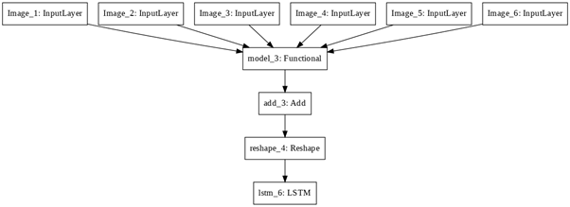
Algorithms and Solution
Encoder Model for Attention:
For this model we have converted our ChexNet Output from 1024 to (7, 7, 1024).
Output of the ChexNet model (7,7,1024) is reshaped using the Reshape layer to (49,1024). So our original image (size 224 x 224) has been converted into 49 areas. For each area, we have 1024 features.
Now, we feed this input to Encoder LSTM, making a sequence of 49 where each data point has 1024 features. From the above layers, we can summarize that our image has 49 words and each word is represented by 1024 numbers.

Slide 11
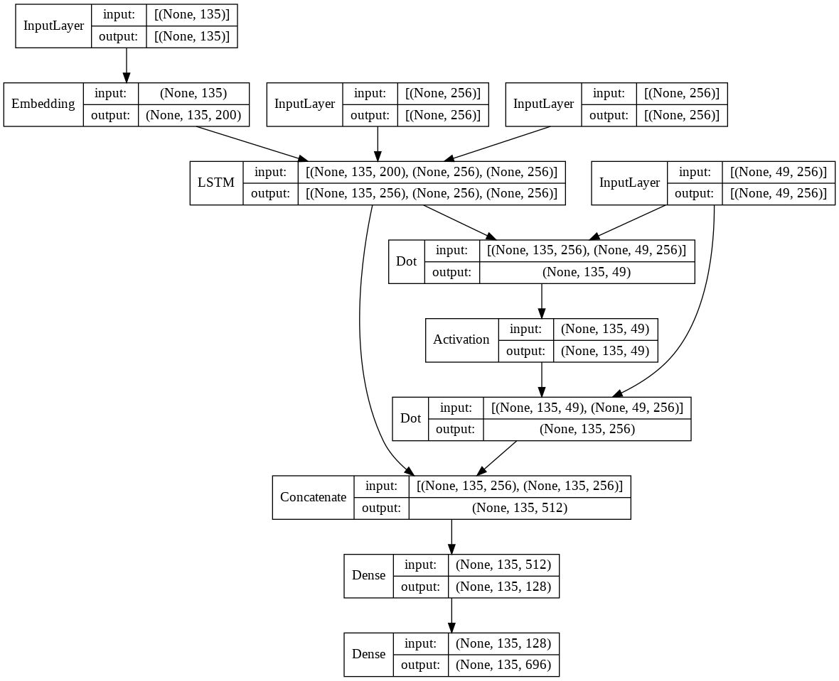
Algorithms and Solution
Decoder Model with Attention:
Attention Matrix
Context Vector

Slide 12
Attention Visualized

Slide 13
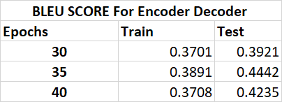
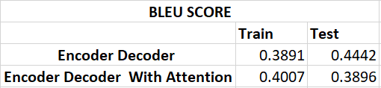
Results
Here is the BLEU score for the Encoder-Decoder Model:
BLEU Score for the best achieved by the model with and without Attention:

Slide 14
Production Deployment and Future Work
Production Deployment Steps:
In the near future, we plan to deploy the model on the AWS production environment. For this, the following steps will be taken:
We will download the Encoder-Decoder model weights, which we have trained fo the highest BLEU score.
We will wrap the inference pipeline logic into a flask application.
Then we will use the docker to containerize the flask application.
We will then host the docker container on an AWS EC2 instance and consume the web-service.
Future work:
MRI images are not readable by us. We as a group will try to consult a SME for MRI images who understands the details of the images which can later help us in training the model and understanding the features of the images in the dataset.
As the dataset contains information for only 510 patients which seems less for training the model accurately, we will try to collect more data of about 2000 patients which might help us in training the model more efficiently.
The clinical reports in the dataset which we used might not be verified. So, while collecting the data we will get opinions from the Radiologists.
The ChexNet model which we used for the Feature Map generation of the images was not that much effective. As a next step we will try to make use of the SpineNet Model or our own convolution layers for extracting more informative Feature maps.
We implemented an attention layer which doesn’t seem to raise the BLEU score quite sharply so for our future work we will try to implement Transformers and GPT-3 models of Sequential NLP which have shown good results in similar kinds of problems.

Slide 15
Conclusion
The solution can be used as a second opinion by the radiologist while writing the diagnosis report of a patient.
This report generated by the model can be used as a reference to create the final report.
We believe that our solution would help improve the accuracy of the MRI report as our model has learnt from thousands of spinal MRI images and their corresponding clinical reports prepared by various radiologists.
The report generated by the model is expected to be near to appropriate. The chances of human errors would be reduced to some extent.
With the Spinal MRI images of a patient, the model would be able to generate the clinical notes with ~ 50% - 60% confidence.
The best BLEU score achieved by the model is 44% on the test data which refers to “Understandable to Good Translations”.

